Slide 1
Project presentation on :- IMAGE SCRAPING AND CLASSIFICATION
Submitted by :
Vivek Rai

Slide 2
Table Of Contents :-
1. Introduction
1.1 Problem Statement and understanding
2. EDA steps and Visualization
3. Data Preprocessing Done
3.1 Set of assumptions related to the problem under consideration
4. Model Dashboard
5. Finalized Model
6. Conclusion
7. Acknowledgement

Slide 3
INTRODUCTION
Problem statement and understanding
Images are one of the major sources of data in the field of data science and AI. This field is making appropriate use of information that can be gathered through images by examining its features and details. We are trying to give you an exposure of how an end to end project is developed in this field.
The idea behind this project is to build a deep learning-based Image Classification model on images that will be scraped from e- commerce portal. This is done to make the model more and more robust.
This task is divided into two phases: Data Collection and Model Building.

Slide 4
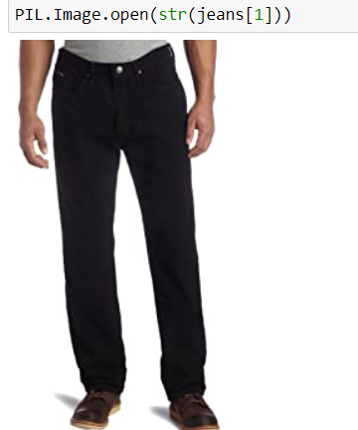
EDA steps and Visualization
Visualizing the image of our first category which is jeans with help of PIL.

Slide 5
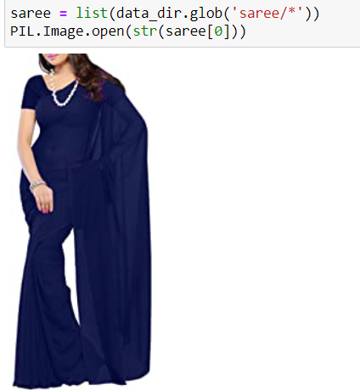
Visualizing the image of our second category which is saree with help of PIL

Slide 6
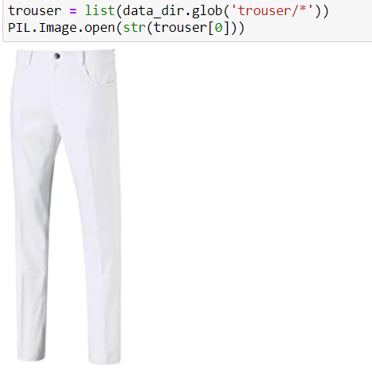
Visualizing the image of our third category which is trouser with help of PIL.

Slide 7
Data Preprocessing Done
We first label the images in our dataset according to their categories as 0 for jeans, 1 for sarees and 2 for trousers.
Then we did some visualization of our dataset.
The images in our dataset are of shape 320, 137, 3 we resize it to the shape 180, 180, 3.
Then we scale images by dividing them with 255 before feeding it to our neaural network.
We noticed that our prior model was overfitting so with the help of data augmentation techniques we increased the number of images in our dataset before feeding it to the convolutional neural network.

Slide 8
Set of assumptions related to the problem under consideration
By looking into the target variable label we assumed that it was a Multiclass classification type of problem.
After knowing that it was image classification problem we assumed that we would be feeding the dataset to convolutunal neural network for better accuracy.

Slide 9
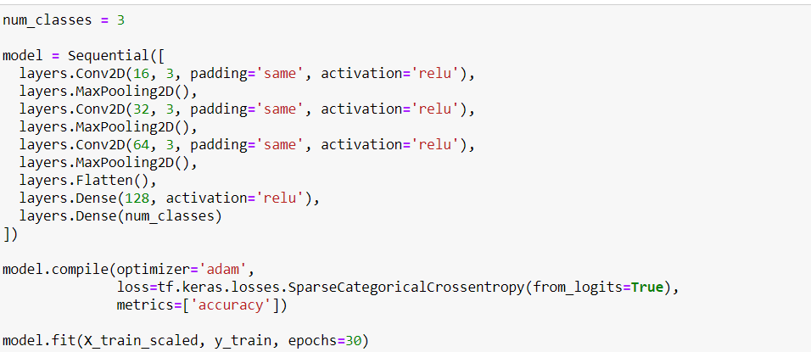
Model Dashboard​
The algorithms we used are shown below,

Slide 10
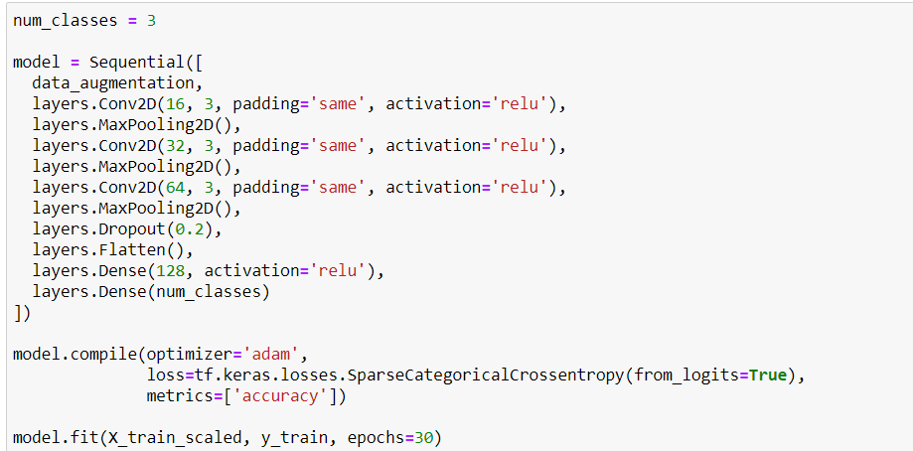
Then after applying some data augmentation techniques we added dropuout layer in our convolutional neural network.

Slide 11
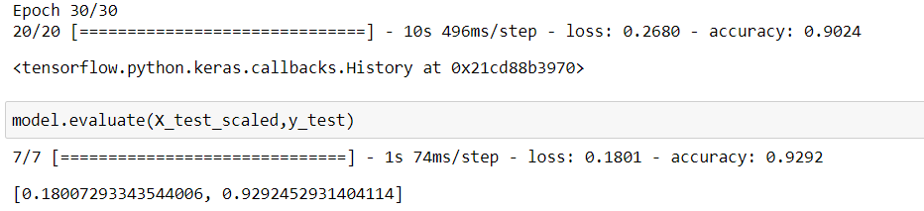
Finalized Model
After performing data augmentatioin techniques and adding a dropuout layer to our dataset we observed that our accuracy of testing dataset improved from 88% to 92.92%.

Slide 12
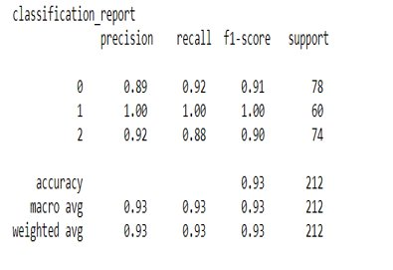
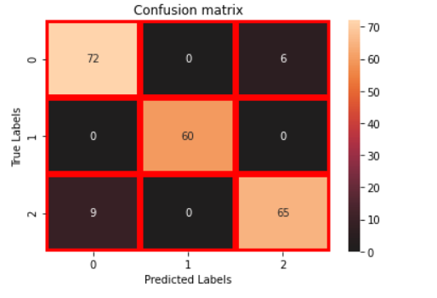

Slide 13
Conclusion
In conclusion, this research is about image classification by using deep learning via framework TensorFlow. The roles of epochs in DNN was able to control accuracy and also prevent any problems such as overfitting. Thus we were able to classify the three categories of images with high testing accuracy of 92.92%.

Slide 14
Acknowledgement
I would like to express my special thanks of grattitude to the sources Medium, TowardsDataScience, StackOverflow, KrishNaik’s youtube channel which helped me to accomplish this project.

